Slide 1


Welcome to the APS Workshop: Automated analysis of pathogen genomes using PathogenSurveillance and the genomeRxiv web server
&

Slide 2








Who we are at Oregon State University and USDA ARS
Zachary Foster
Martha Sudermann
Camilo Parada-Rojas
Logan Blair
Fernanda Iruegas-Bocardo
Alex Weisberg
Jeff Chang
Nik Grünwald

Slide 3






Who we are: Virginia Tech
Boris Vinatzer
Reza Mazloom
Janet Lorv
Sehgeet Kaur
Mitchell Gercken
Kassaye Belay

Slide 4


Apply for workshop fee reimbursement!
We have funding for reimbursing your workshop fee
Please email Janet Lorv jshlorv@vt.edu: your name, mailing address, and receipt
2023-67013-3992

Slide 5
Why analyze plant pathogen genomes?
Diagnostics
Surveillance/Biosecurity
Ecology and Evolution
Molecular Epidemiology
Molecular Plant-Microbe Interactions
… anything else? Why are you here?

Slide 6
Who are you?
Pratima Devkota | Michigan State University
Korsi Dumenyo | Tennessee State University
Andres Espindola | Oklahoma State University
Janis A. Fomba | University of Nebraska-Lincoln
Anupa Gaire | Oregon State University
David H. Gent | Oregon State University
Bikash Ghimire | University of Georgia
Jilly Sal Greenberger | USDA-ARS
Douglas S. Higgins | Virginia Tech
Keigo Imai | South Dakota State University
Samuel Martins | University of Florida
Rebecca A. Melanson | Mississippi State University
Marysabel Mendez Acevedo | Penn State
Oloyede Joshua Oyekanmi | University of Arizona
Imana L. Power | Louisiana State University
Alina Puig | USDA-ARS
Eduardo Vicentin | Kansas State University
Alex Dmitry Vompe, PhD | Penn State
Philip Waisen | University of California
Hsuan Fu Wang | University of Minnesota
Ru-Bin Yao | National Chung Hsing University

Slide 7
Detection versus Identification
Detection: Is a specific already known and characterized pathogen present or not?
Identification and Characterization: what species and/or strain is the unknown (possibly emerging) pathogen that causes an undiagnosable disease, what is the source, and what are its characteristics?
Both Genomics and Metagenomics are best suited for Identification and Characterization

Slide 8
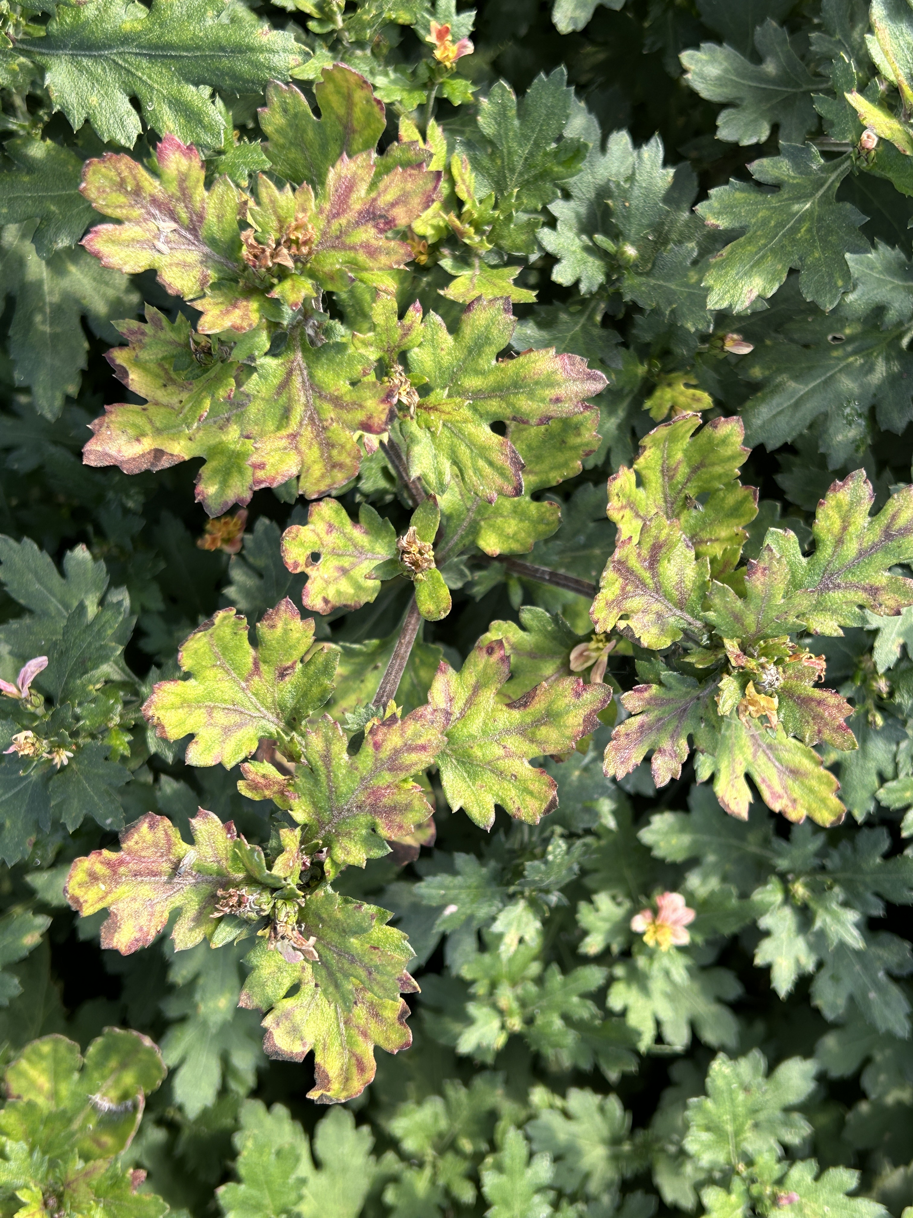
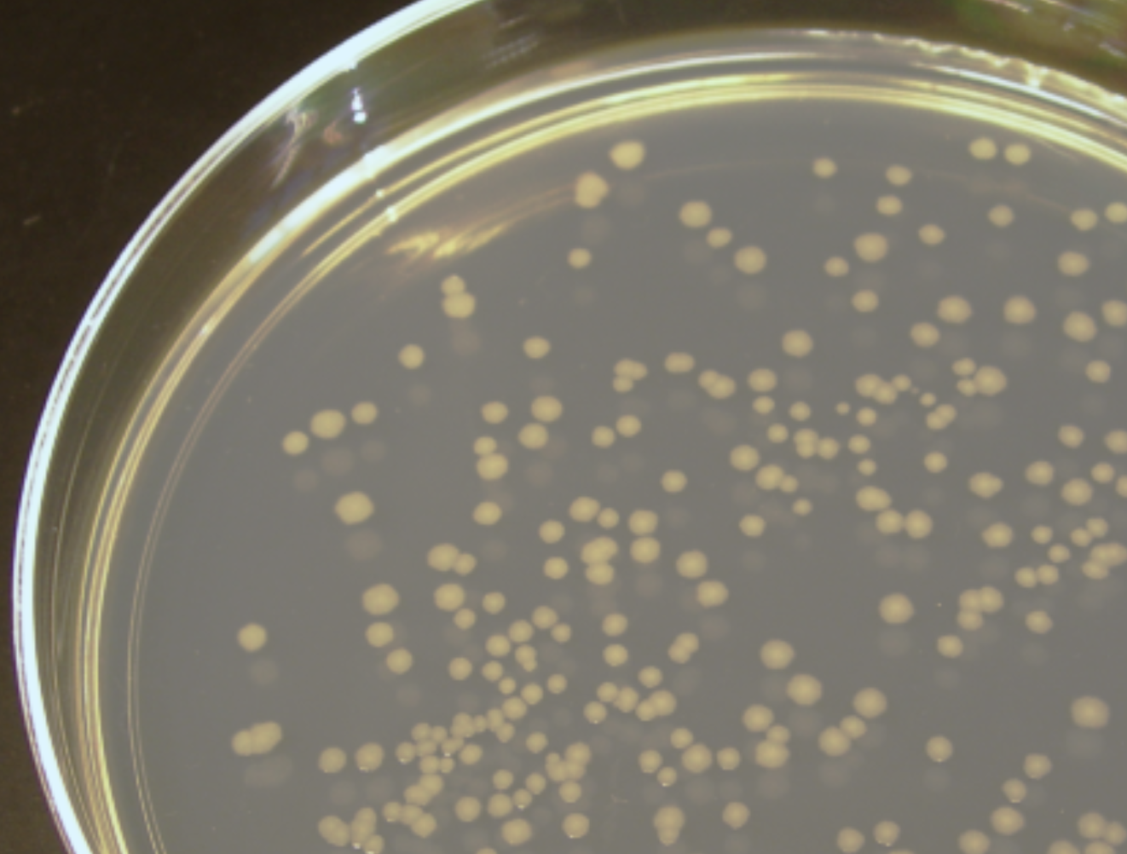
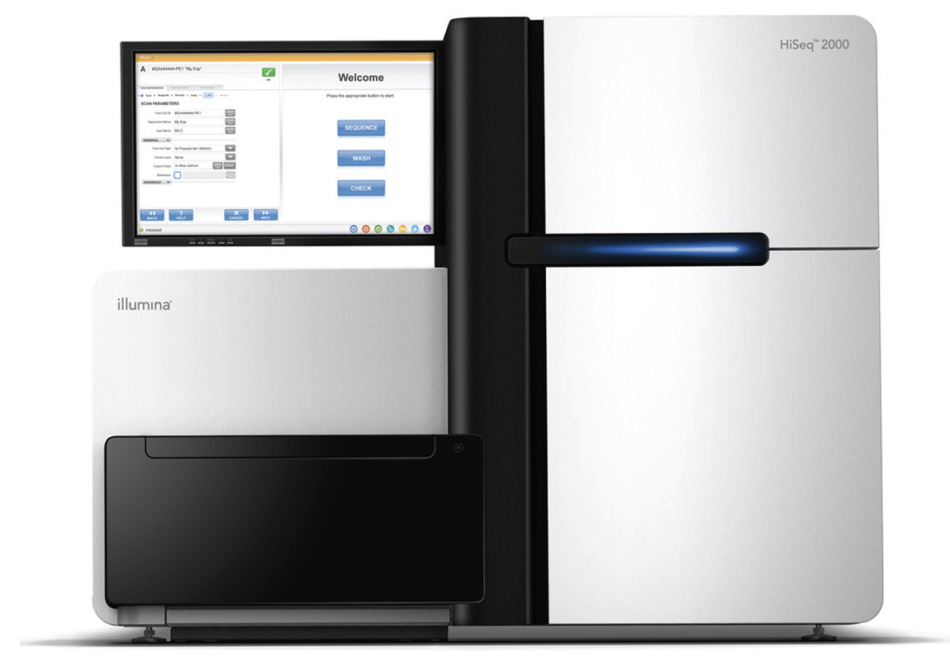
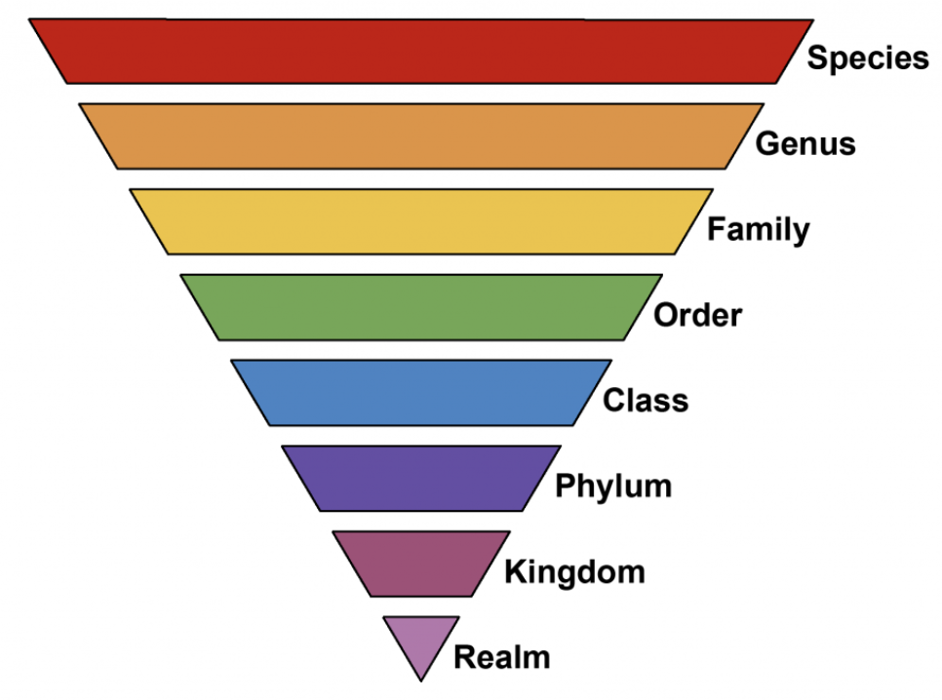
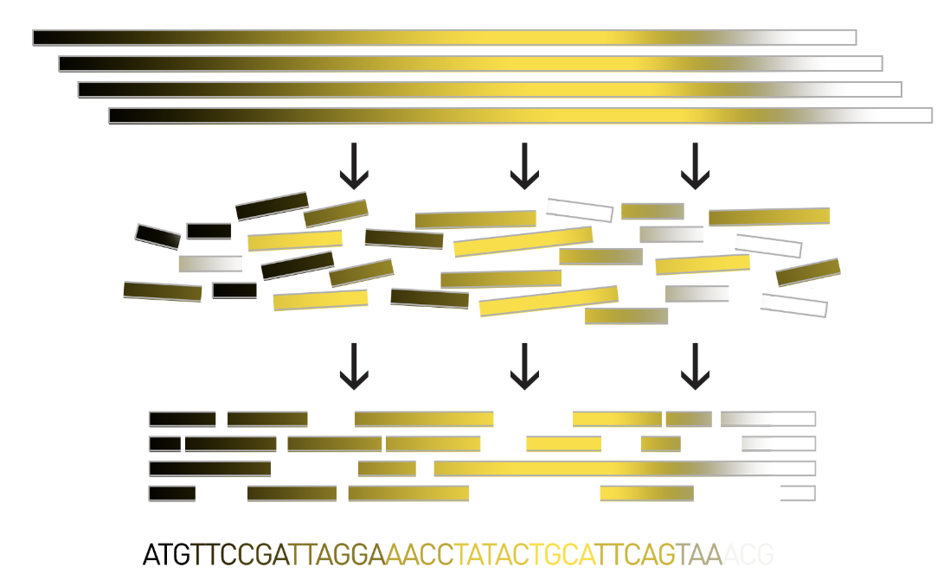
Genomics
Phylogenetics
Comparative genomics
Functional genomics
…
Replace pyramid!

Slide 9
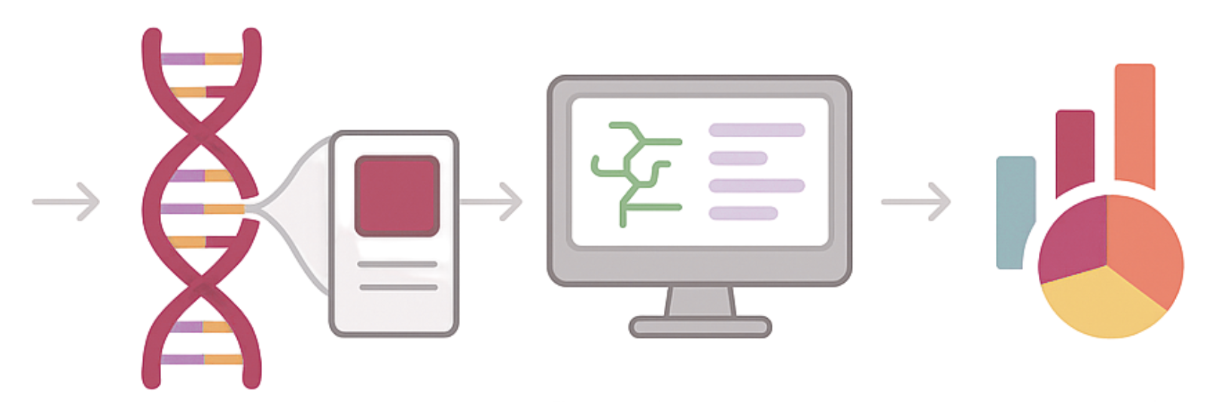
What is metagenomics?
Metagenomics to study microbiomes
Metagenomics to identify a putative pathogen
*
Phylogenetics
Comparative genomics
Functional genomics
…

Slide 10
How to make (meta)genomics easier?

Slide 11
Workshop Overview
Learn how to work with the nf-core pipeline PathogenSurveillance (PS) and the genomeRxiv web server.
PS is a population genomic pipeline for pathogen diagnosis, variant detection, and biosurveillance.
The genomeRxiv web server provides a powerful method to infer the identities of bacterial pathogens at within-species resolution in one step either using assembled genomes or “k-mer signatures” of unassembled genomes as queries (fungal and oomycete version under development).
Together these two approaches simplify and accelerate use of genome sequencing in disease diagnosis by returning multiple outputs to cross-validate pathogen identification. They also accelerate whole genome data processing and analyses for use in fundamental research.

Slide 12
Workshop Learning objectives
Learn to analyze whole genome sequences for pathogen identification to detect species and novel variants. Find closest known reference genome, map genomes against reference, call variants, obtain multigene phylogenies.
Execute nf-core/PathogenSurveillance pipeline in linux. Submit script to run pipeline, interpret report obtained. Learn to analyze data beyond what report provides using your own custom scripts in R.
Search genomeRxiv and interpret results. Learn to identify bacterial species using k-mer signatures against genomeRxiv. Use the Life Identification Number (LIN) to ID unknowns. Explain use and interpretation of LINs.

Slide 13
Agenda
Pathogensurveillance (~45 Minutes)
Demo
Lecture
Back to demo
GenomeRxiv (~2 hours 30 minutes)
Introduction to the genome-based approach used by genomeRxiv​
Demo and Hands-on session of the genomeRxiv web server​
Break
Short overviews of fungal, oomycete, and viral identification and metagenomics​
Demo of BrookLIN to access genomeRxiv through the API​
Conclusions and Q&A (~30 minutes)

Slide 14
For the end of the workshop

Slide 15
Strengths of using (meta)genomics for diagnostics and surveillance
Pathogen-agnostic (in particular metagenomics)
Potentially fast
Potentially highly sensitive
Potentially provides high resolution/strain resolution (high abundance pathogen)
Potentially can predict antibiotic/fungicide resistance and virulence
Potentially cheap for low-throughput analyses

Slide 16
Weaknesses of using (meta)genomics for diagnostics and surveillance
Potentially slow
Potentially low sensitivity (compared to qPCR, for example)
Potentially only provides low resolution (low abundance pathogen)
Results heavily depend on quality of reference databases and bioinformatics tools used
Computationally expensive
Potentially very expensive (compared to qPCR, for example)

